Slide 1
Capstone Project – The Battle of Neighborhoods
Selecting the best location to open an Italian Restaurant in Brooklyn, NYC.

Slide 2
Introduction:
The City of New York, is the most populous city in the United States. It is diverse and is the financial capital of USA. It is multicultural with 19.45 million people. New York City welcomed a record of 65.2 million visitors, comprising 51.6 million domestic and 13.5 million international visitors in 2019, It provides lot of business opportunities and business friendly environment. one of Largest cities by population in New York is Brooklyn, this city has a lot of immigrants from all over the world with many cultural diversity which allowing a huge types of cuisines one can offer in the restaurant business.
Demographics of Brooklyn:-
Ancestry number % of total population
Italian 157,068 6.1%
Irish 100,923 3.9%
Russian 88,766 3.5%
Polish 71,099 2.8%
German 53,188 2.1%
English 36,174 1.4%
As it is highly developed city so cost of doing business is also one of the highest. Thus, any new business venture or expansion needs to be analyzed carefully. The insights derived from analysis will give good understanding of the business environment which help in strategically targeting the market. This will help in reduction of risk and the return on investment will be reasonable.
Our analysis will be covered the following factors:
The best location to start the business.
The types of our target Customers.
defined our Potential competitors?

Slide 3
Business Problem
My client wants to open an Italian restaurant in Brooklyn, NYC. There are a big challenge to start a business in Brooklyn because of high competition.
We want to choose the best location based on the number of Italian restaurant which are open in each neighborhood.
To start a new business, the business should be opened in neighborhood with less competitors.
We will focus in our analysis to choose the best location to start the business to ensure that the location has enough customers and we are not close to other Italian restaurants.

Slide 4

Data Selection
To Identify the best location to start the business in Brooklyn, I need to find out the number of our competitors in each neighborhoods in Brooklyn .
I used NYC OpenData to import the data of "Neighborhoods in New York City
https://data.cityofnewyork.us/City-Government/Neighborhood-Tabulation-Areas-NTA-/cpf4-rkhq
I used Forsquare API to get the most common venues of given Borough of Brooklyn.
https://foursquare.com/
In Brooklyn, there is 576 Italian restaurants are currently operating.

Slide 5
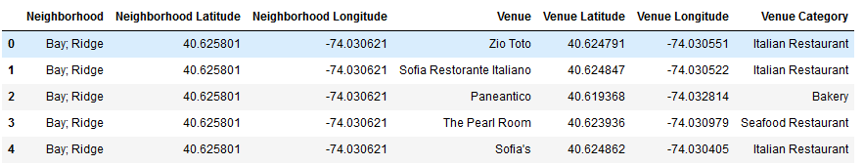
Data Selection
I used Google API to find their geographic coordinates of the 5 locations shortlisted for our itlian restaurant:-

Slide 6
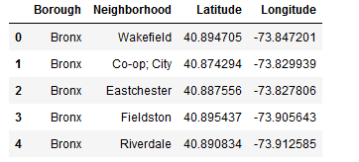
Methodology
As a database I used OpenData in my study. My master data which has the main components Borough, Neighborhood, Latitude and Longitude

Slide 7
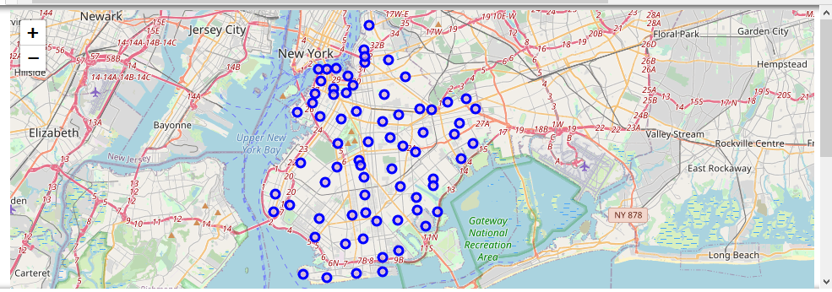
Methodology
I used python folium library to visualize geographic details of Brooklyn and its boroughs and I created a map of NYC with Brooklyn Neighborhood. I used latitude and longitude values to get the visual as below:

Slide 8
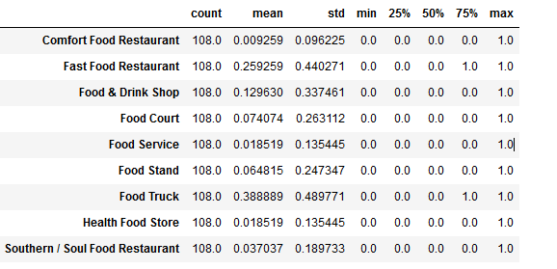
Methodology
find out the top 10 food categories in Brooklyn:

Slide 9
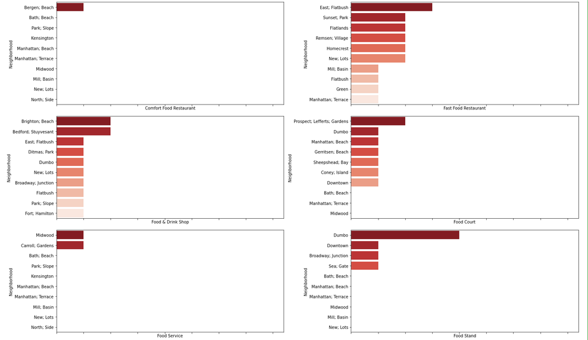
Methodology

Slide 10
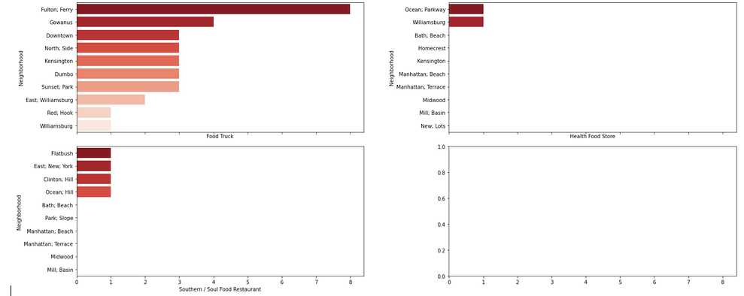
Methodology

Slide 11
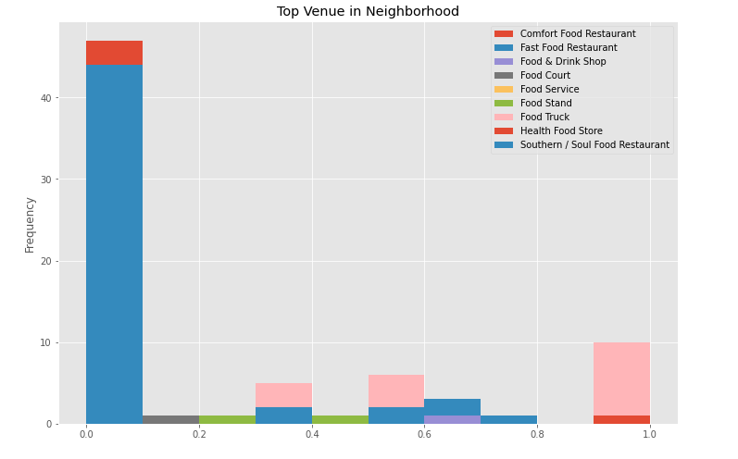
Methodology
We can see that Comfort Food Restaurant and Fast Food how reached the 45 limit of venues. On the other hand; Food Court, Food Stand and Southern / Soul Food Restaurant are below 5 venues in our given coordinates with Latitude and Longitude, in below graph.

Slide 12
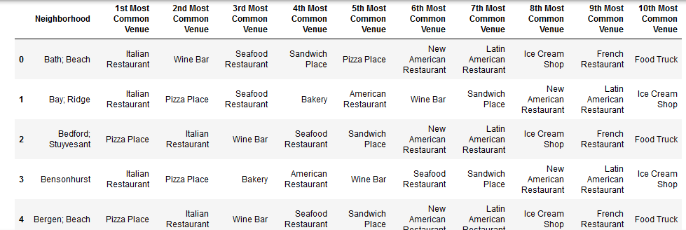
Methodology
In summary of this graph 63 unique categories were returned by Foursquare, then I created a table which shows list of top 10 venue category for each borough in below table.

Slide 13
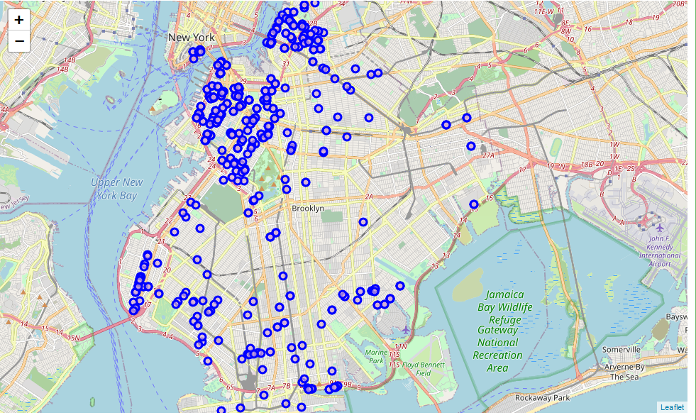
Methodology
I used python folium library to visualize geographic details of Italian restaurants in Brooklyn and I created a map.

Slide 14
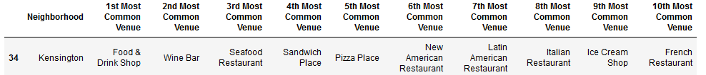
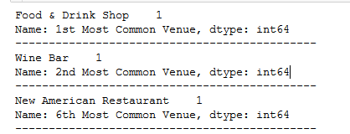
Results
Using K-mean to clustering data area with less number of Italian restaurants.
Cluster 0

Slide 15
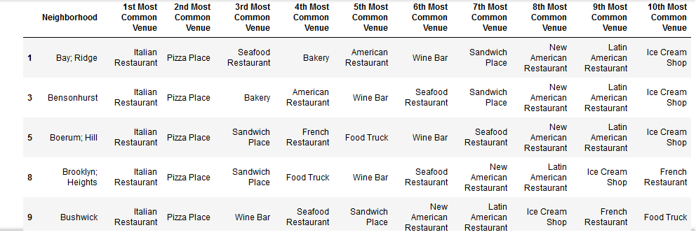
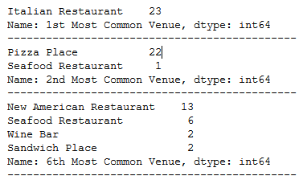
Results
Cluster 1

Slide 16
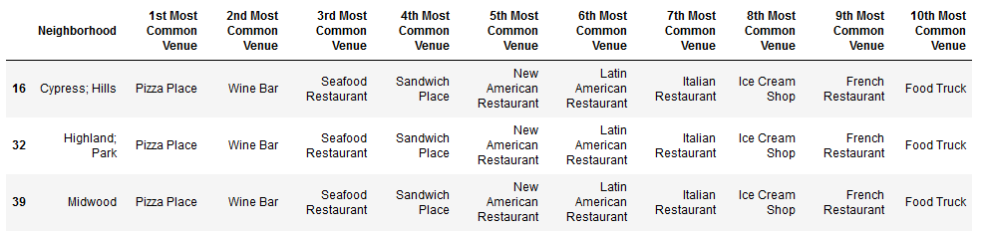
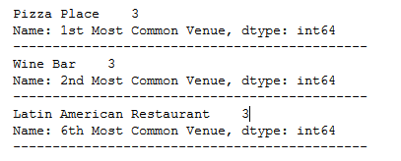
Results
Cluster2

Slide 17
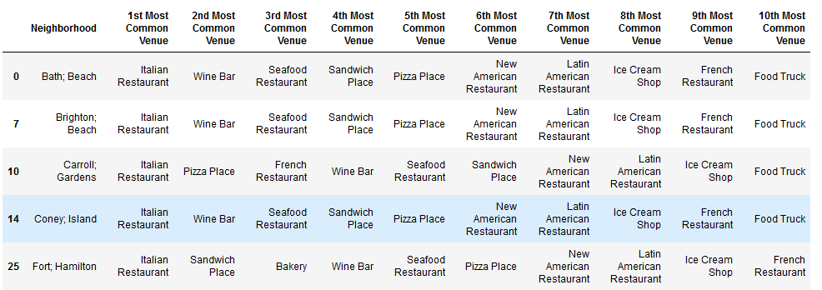
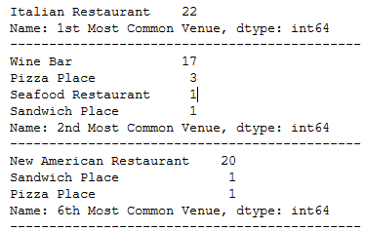
Results
Cluster 3

Slide 18
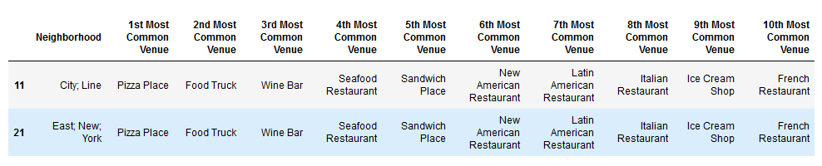
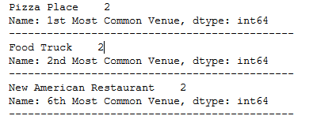
Results
Cluster 4

Slide 19
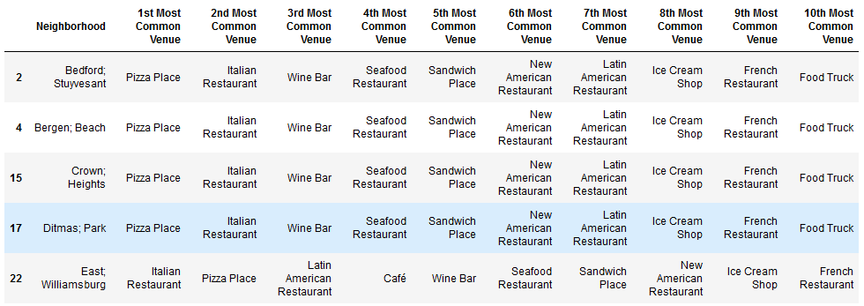
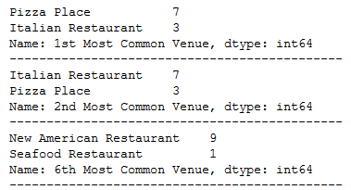
Results
Cluster 5

Slide 20
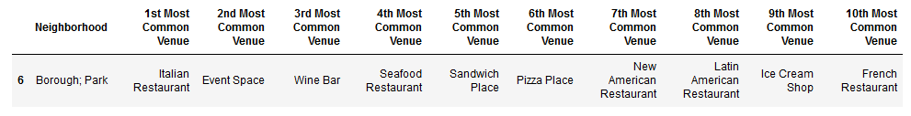
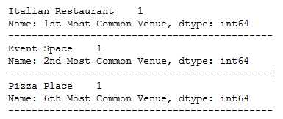
Results
Cluster 6

Slide 21
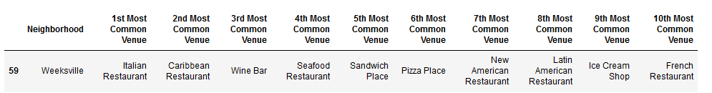
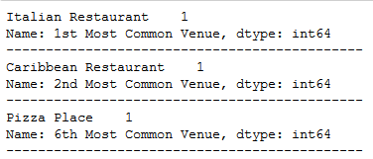
Results
Cluster 7

Slide 22
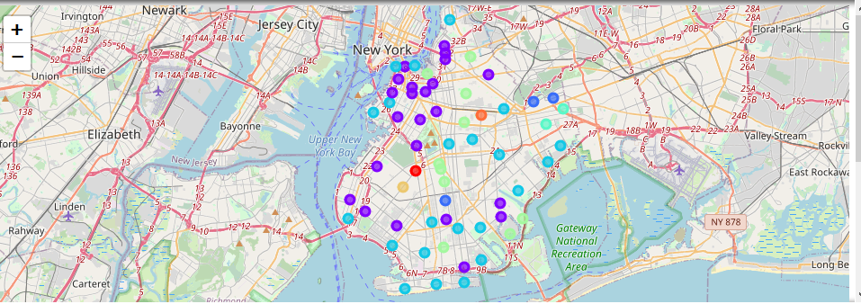
Results

Slide 23
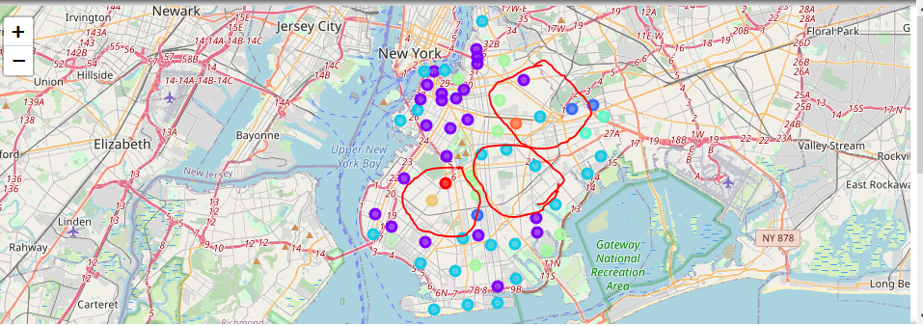
Results
Based on the dataframe analysis above cluster0, cluster4, clsuter6 and cluster7 areas are the best place to start an new Italian Restaurant.

Slide 24
Discussion
As I mentioned before, The City of New York, is the most populous city in the United States. It is diverse and is the financial capital of USA. It is multicultural with 19.45 million people, It provides lot of business opportunities and business friendly environment. one of Largest cities by population in New York is Brooklyn, this city has a lot of immigrants from all over the world with many cultural diversity which allowing a huge types of cuisines one can offer in the restaurant business.
I used the K-means algorithm as part of this clustering study. When I tested the Elbow method, I set the optimum k value to 8. However, only 7 district coordinates were used. For more detailed and accurate guidance, the data set can be expanded and the details of the neighborhood or street can also be drilled.
There is a high competition in the Brooklyn downtown and Beach area.

Slide 25
Conclusion
All the goals of this study were met there is a room for further improvement and development, however we successfully defined:-
1- The best location to start the business.
2- The types of our target Customers.
3- defined our Potential competitors.

Slide 26
References:
[1] Brooklyn – Wikipedia
[2] NYC OpenData
[3] Forsquare API
[4] Google Map

